Slide 1
Phase 2: Attack Execution & Memory Acquisition
Project: Memory Forensics & Credential Extraction using Mimikatz & Volatility
Team:
Devarshi Mahadevwala
Purpose of Phase 2:
Conduct a controlled credential-theft attack
Capture three memory states for forensic comparison
Prepare dataset for Volatility-based analysis in Phase 3

Slide 2
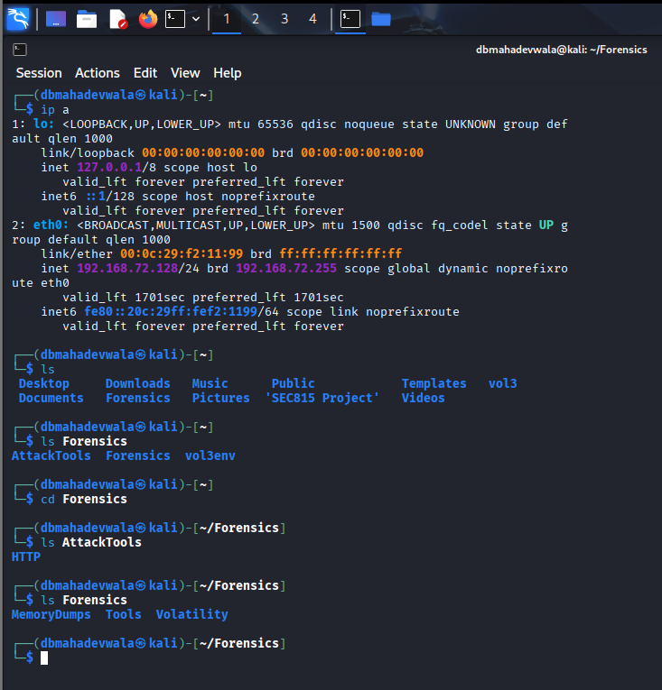
Attacker VM Prepared (Kali Linux)
Verified network isolation (Host-Only) to simulate internal compromise
Confirmed correct directories for payload, memory dumps, and Volatility workspace
Ensured attacker VM could communicate reliably with Windows victim
Verified available disk space & tools before attack execution

Slide 3
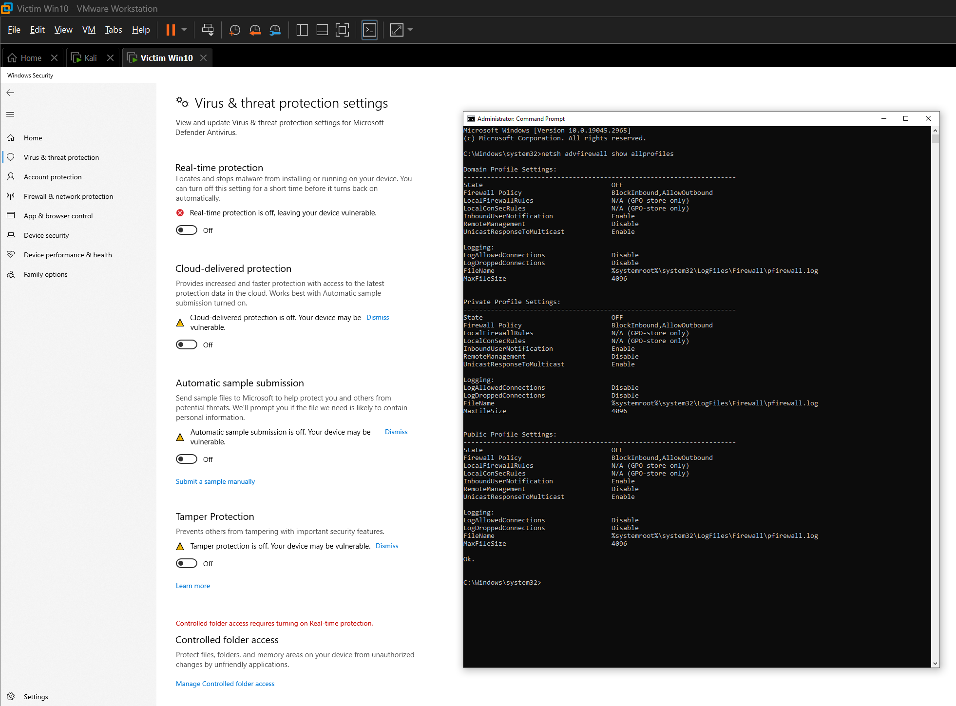
Windows Security Controls Disabled
Disabled Defender & Firewall to:
Prevent blocking of Mimikatz
Allow unrestricted payload execution
Ensure realistic credential extraction
This setup matches typical misconfigured enterprise environments

Slide 4
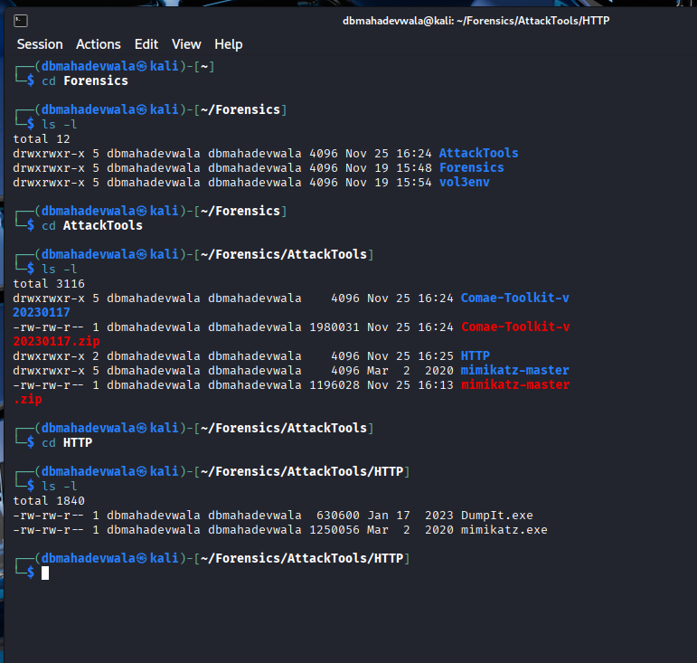
Payload Staging Environment
Organized attack tools (DumpIt.exe, mimikatz.exe) into a dedicated staging directory
Ensured Windows-compatible binaries placed inside HTTP server folder
Established a clean and repeatable payload delivery system

Slide 5
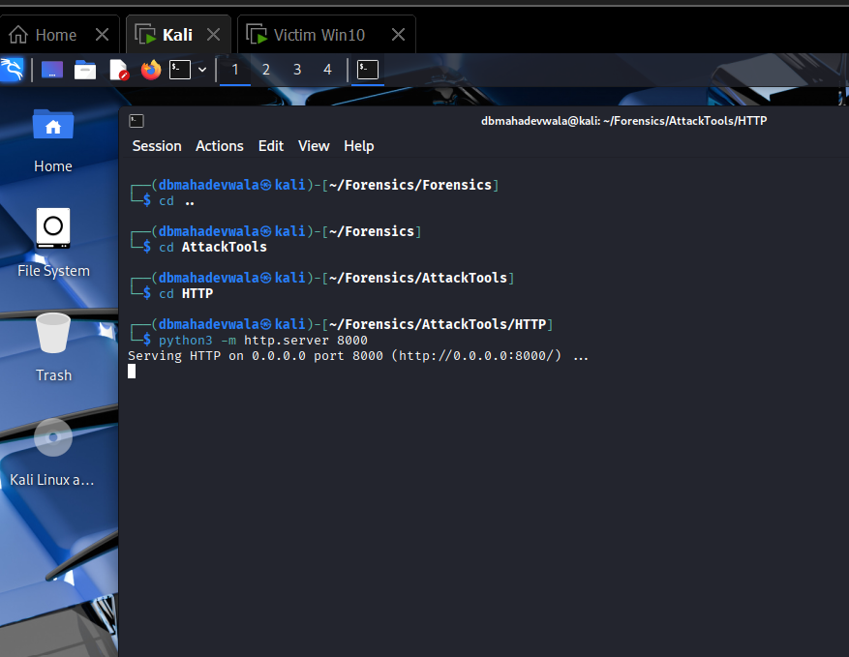
HTTP Delivery Mechanism Activated
Kali’s Python web server used to host attack tools
Windows VM accessed tools via browser — simulates phishing/download scenario
Validated accessibility & transfer integrity before running tools

Slide 6
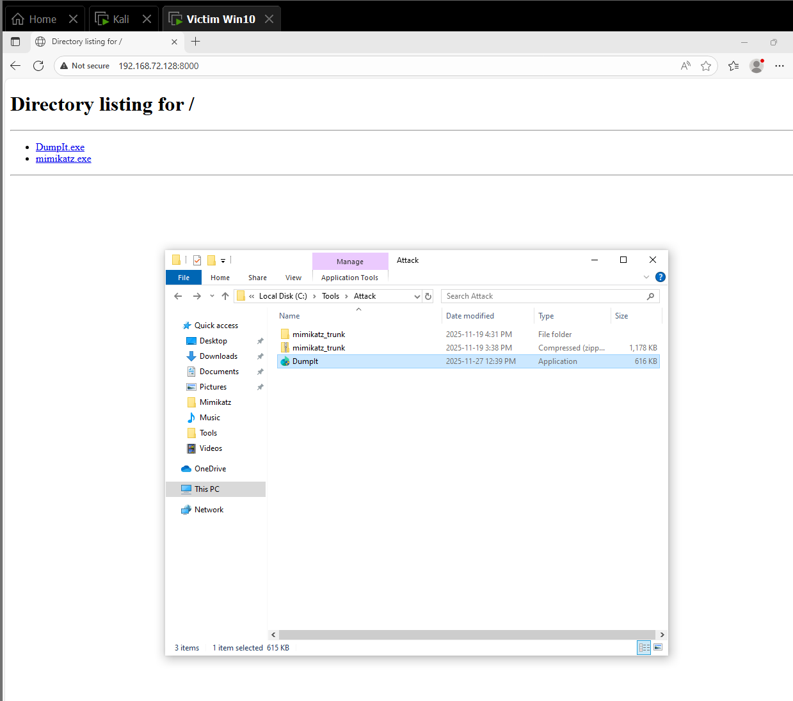
Victim Downloads DumpIt
Windows VM successfully connected to Kali server
Downloaded DumpIt for memory capture
Prepared baseline memory snapshot before any malicious action

Slide 7
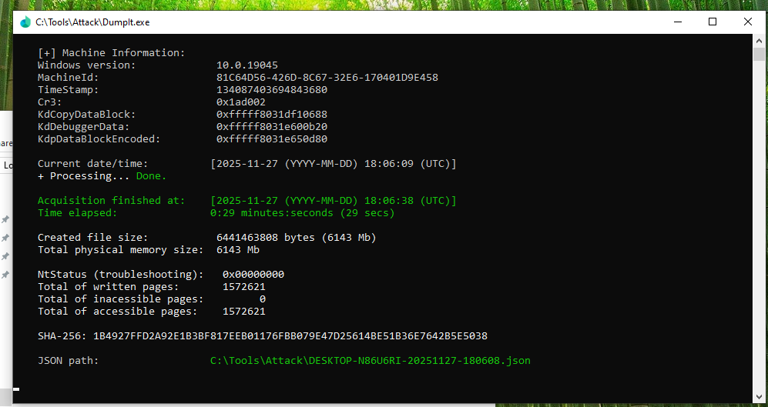
Pre-Attack Memory Snapshot Captured
DumpIt executed on a clean system
Captured memory_pre_attack.dmp
Provides baseline for comparing malicious changes in later dumps
Forms the foundation of forensic timeline analysis

Slide 8
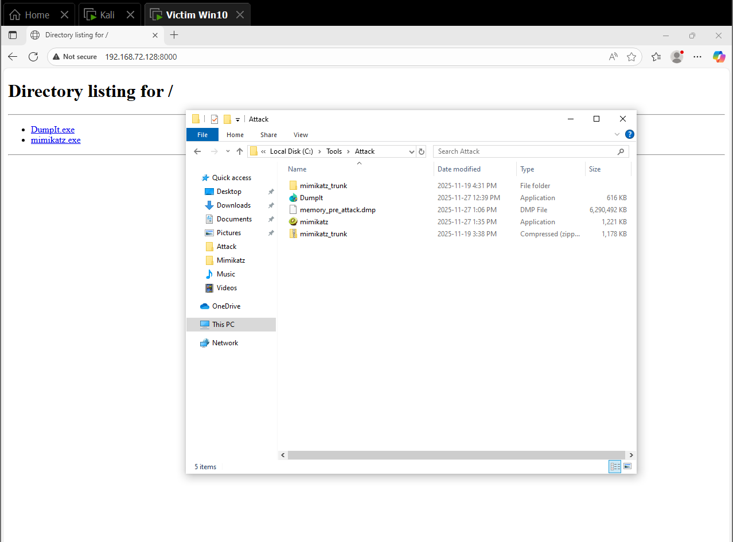
Mimikatz Payload Delivered to Victim
Mimikatz.exe downloaded from Kali
Verified file integrity and correct architecture (x64)
Victim system is now ready for credential extraction testing

Slide 9
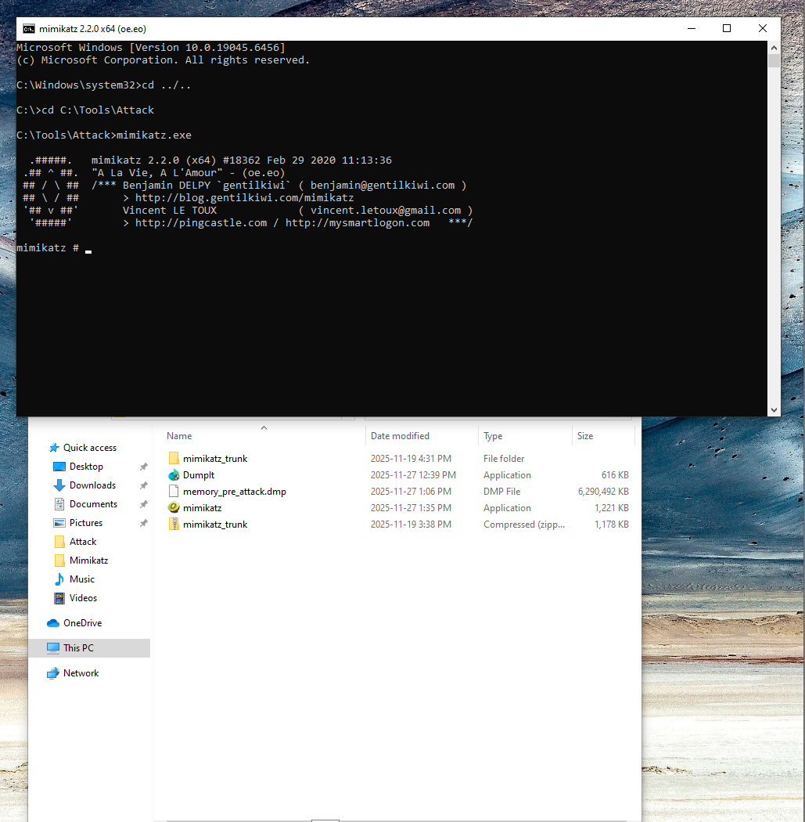
Mimikatz Executed with Elevated Privileges
Mimikatz run using admin shell
Successfully accessed LSASS process
Attack simulates credential harvesting within a compromised host
Proof that payload was executed exactly as intended

Slide 10
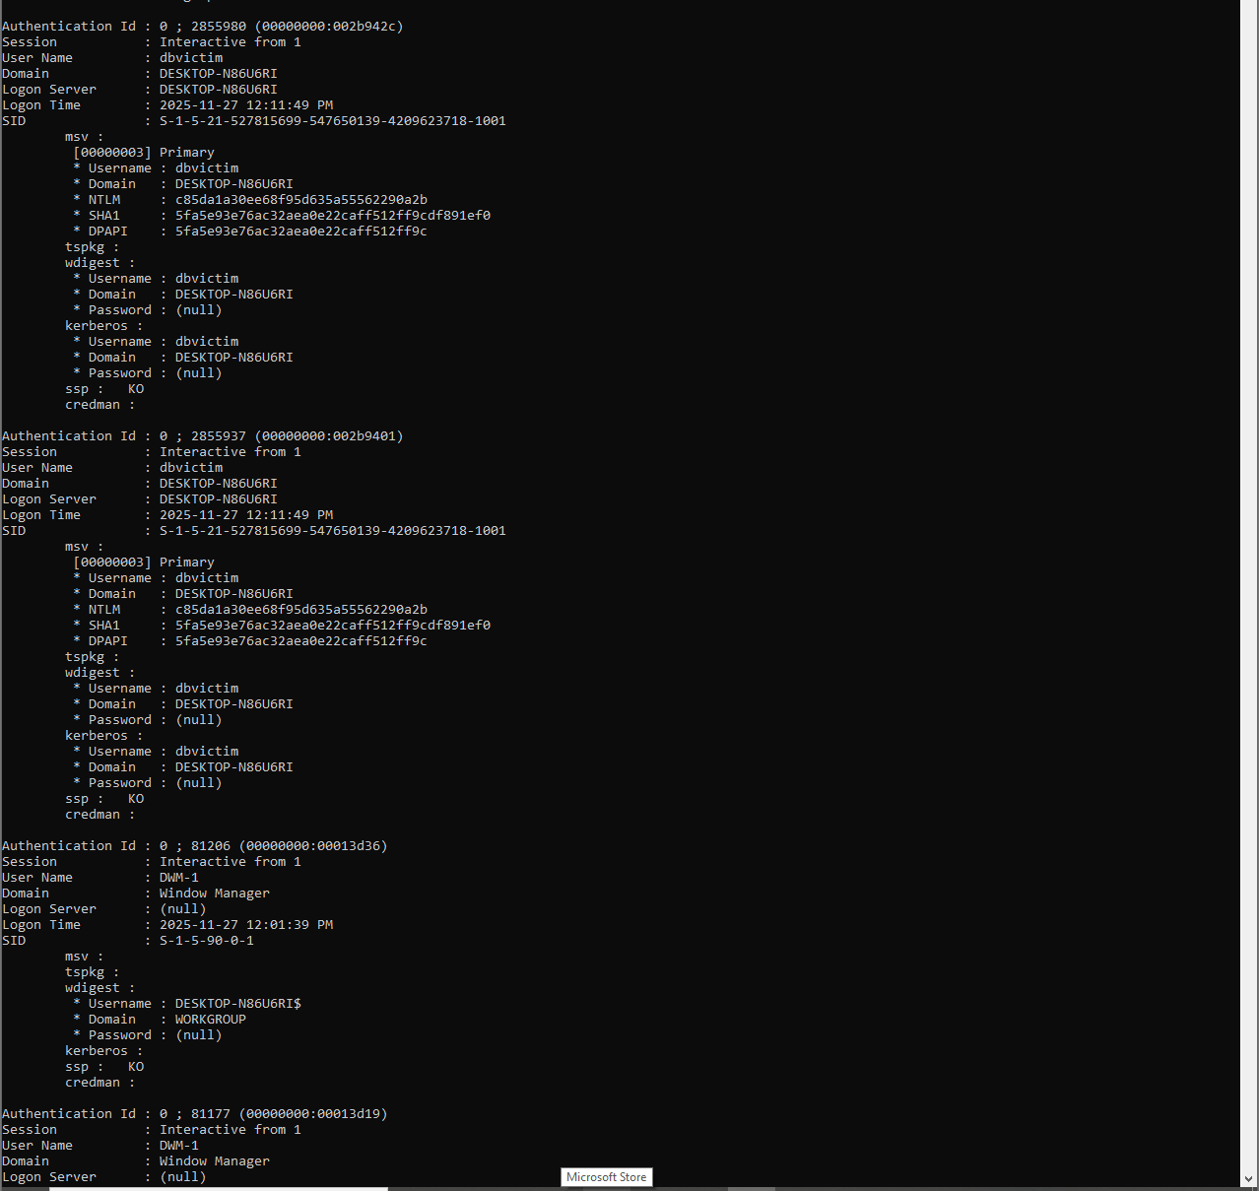
Credentials Extracted
NTLM hashes and credential packages retrieved
Demonstrates full compromise of authentication subsystem
This is the forensic “smoking gun” in Phase 2

Slide 11
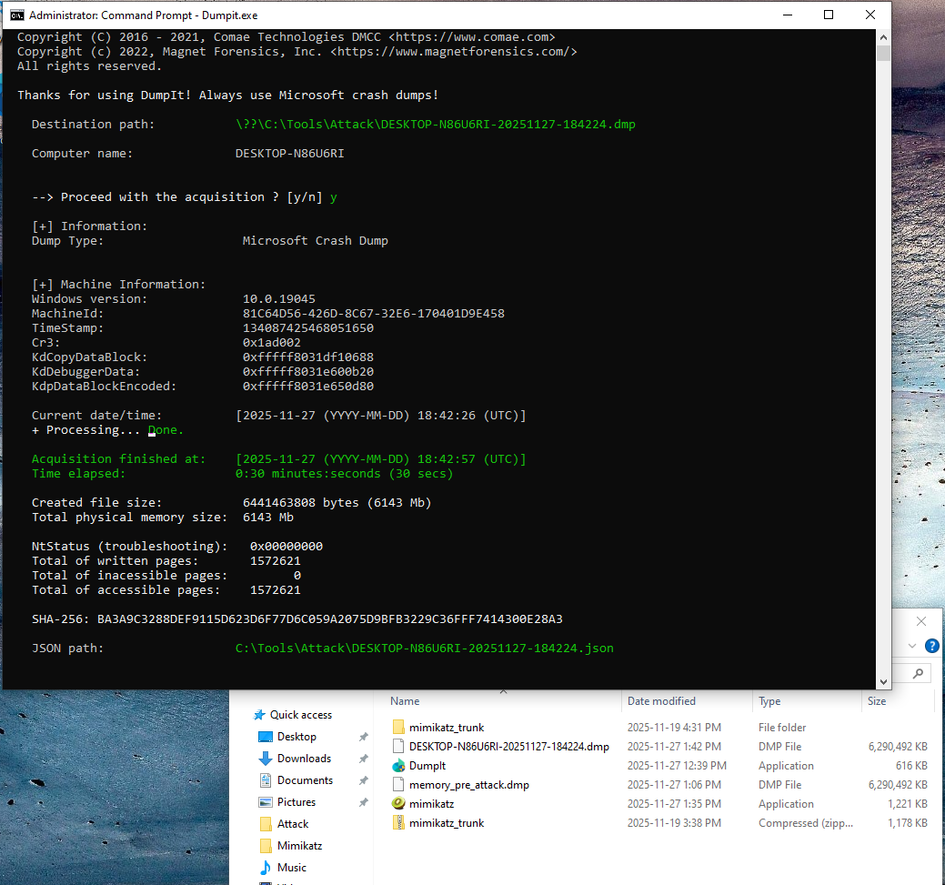
During-Attack Memory Dump
Memory captured while Mimikatz was still active
Captures volatile artifacts (handles, DLLs, LSASS state)
Critical for timeline reconstruction and malware behavior analysis

Slide 12
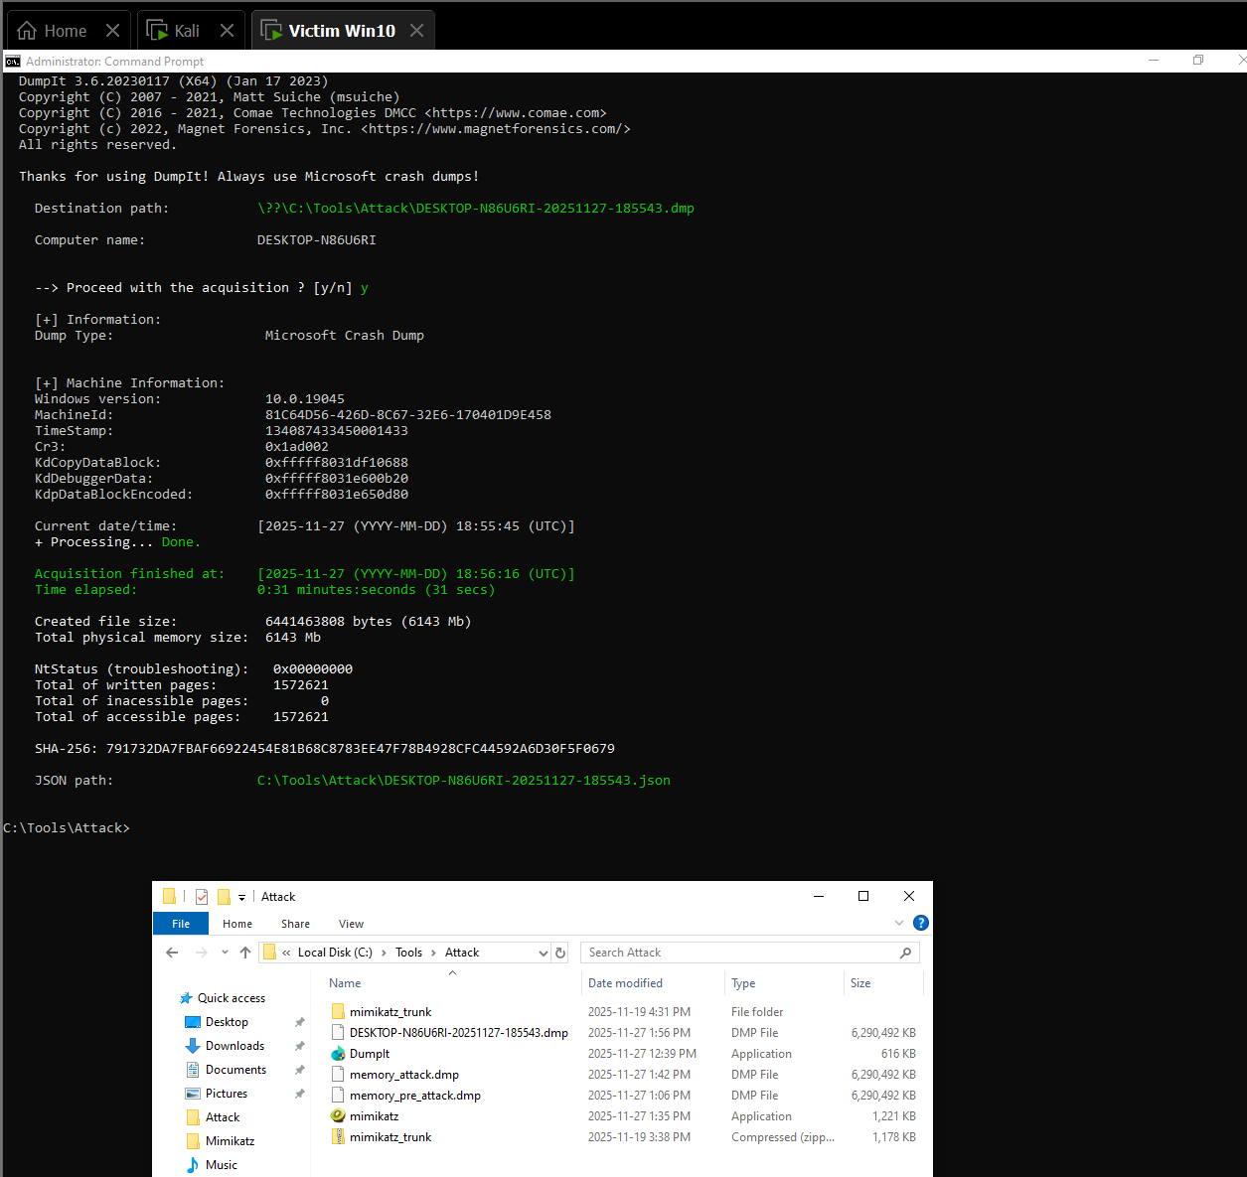
Post-Attack Memory Dump
Mimikatz terminated to simulate attacker exit behavior
Another dump captured to show what persists after the attack
Helps determine what traces remain after tool termination

Slide 13
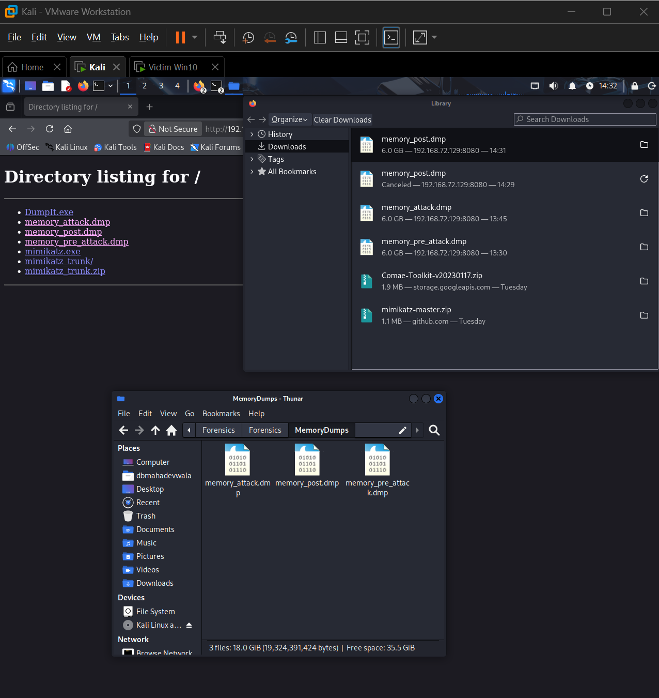
All Dumps Retrieved for Forensic Analysis
All three dumps successfully transferred to Kali
Verified SHA256 to ensure no corruption during transfer
Environment fully prepared for Phase 3 (Volatility 2 & 3)

